Slide 1
POWERPOINT TEMPLATE
We would like to offer you a stylish and reasonable presentation that will help you to promote your business

Slide 2
01
Introduction
1.1
Impact of Bird strike
02
Problem Statement
03
About the Data
04
List of Case Studies
05
KPIs Extracted
06
Visuals depicting the Analysis
07
Bird Strike Analysis Dashboard
CONTENTS
08
Impressions

Slide 3
01
Introduction
Bird strike refers to a collision between an airborne animal and an aircraft. Bird strikes
can have various impacts depending on factors such as the size and speed of the bird,
as well as the location of the strike on the aircraft. Most accidents occur when a bird
(or group of birds) collides with the windscreen or is sucked into the engine of jet
aircraft. This can occur during takeoff, landing, or during flight. Bird strikes can be
considered as a severe threat to the aircraft potentially causing damage to the aircraft's structure, engines, or other critical components.
To mitigate these risks, airports and aviation authorities employ various measures,
such as wildlife management programs and technological solutions, to reduce the
likelihood of bird strikes. Bird strike is also sometimes refers as bird hit or Bird Aircraft
Strike Hazard (BASH). The term is also used for bird deaths resulting from collisions
with structures, such as power lines, towers and wind turbines.

Slide 4
1.1
Impact of Bird strike
Structural Damage: Bird strikes can cause damage to the aircraft's structure, including the
fuselage, wings, and control surfaces. This damage may require extensive repairs and can lead to costly downtime for the aircraft.
Engine Damage: One of the most significant concerns with bird strikes is damage to the aircraft's engines. Birds can be ingested into jet engines, causing engine failure or reduced performance.
Even smaller birds can cause significant damage to engine components, necessitating inspection and potentially costly repairs.
Safety Risks: Bird strikes pose a safety risk to passengers and crew onboard the aircraft. In some
cases, bird strikes have led to emergency landings or accidents resulting in injuries or fatalities.
Financial Costs: Bird strikes can result in significant financial costs for airlines, including repair
expenses, operational disruptions, and potential legal liabilities.
Environmental Impact: Bird strikes can also have environmental consequences, particularly if the aircraft needs to jettison fuel or if there are concerns about the impact of debris resulting from
the strike.

Slide 5
02
Problem Statement
Transport and communication are in the crucial domain in the field of analytics. Environmental impacts and safety are, nowadays, two major concerns of the scientific community with respect to transport scenarios and to the ever-growing urban areas. These issues gain more importance due to the increasing amount of vehicles
and people. Seeking new solutions is reaching a point where available technologies
and artificial intelligence, especially MAS, are being recognized as ways to cope with and tackle these kinds of problems in a distributed and more appropriate way.
Bird Strike is common and can be a significant threat to aircraft safety. For
smaller aircraft, significant damage may be caused to the aircraft structure and all
aircraft, especially jet-engine ones, are vulnerable to the loss of thrust which can
follow the ingestion of birds into engine air intakes. This has resulted in several fatal
accidents.
Bird strikes may occur during any phase of flight, but are most likely during
the take-off, initial climb, approach and landing phases due to the greater numbers of birds in flight at lower levels.

Slide 6
03
About the Data
The analysis is conducted on the data collected on bird strikes by FAA between 2000 and 2011
The data is collection over the time period of 2000-2011
There are 25558 Records and 26 features
Null values are omitted during the visualisation
Out of these 26 ,some columns shows Null values, count of the same as follows;
129 Null values: Aircraft: Type , Airport: Name ,Altitude bin, Wildlife: Number
struck , Effect: Impact to flight , Effect: Impact to flight , Flight Date ,Aircraft:
Airline/Operator, When: Phase of flight, Wildlife: Size ,Pilot warned of birds or wildlife? ,Feet above ground, Is Aircraft Large?
267 Null values: Aircraft: Number of engines?
449 Null values: Origin state
4771 Null values: Remarks

Slide 7
04
List of Case Studies
● Visuals Depicting the Number of Bird Strikes
● Yearly Analysis & Bird Strikes in the US
● Top 10 US Airlines in terms of having encountered bird strikes
● Airports with most incidents of bird strikes – Top 50
● Yearly Cost Incurred due to Bird Strikes:
● When do most bird strikes occur?
● Altitude of aeroplanes at the time of strike
● Phase of flight at the time of the strike.
● Average Altitude of the aeroplanes in different phases at the time of strike
● Effect of Bird Strikes & Impact on Flight
● Effect of Strike at Different Altitude
● Were Pilots Informed? & Prior Warning and Effect of Strike Relation

Slide 8
05
KPIs Extracted
$14,22,90,445
Total Cost
25429
Total Bird Strikes
27
Total Injuries
292
Number of Airports

Slide 9
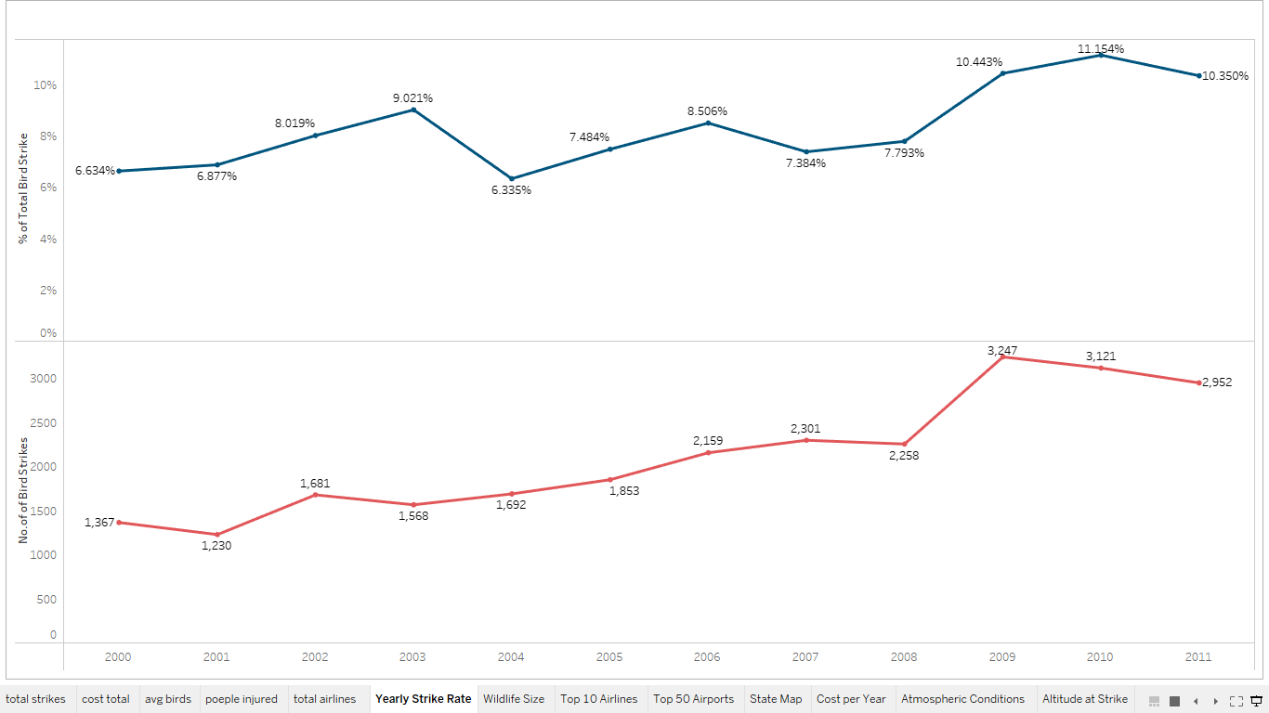
Yearly Analysis & Strike Rate in the US
06

Slide 10
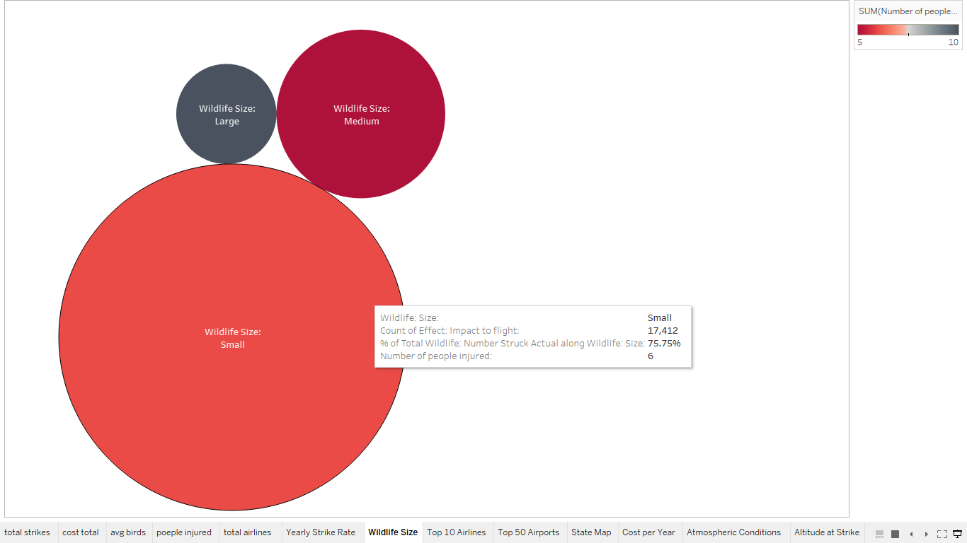
Number of bird strikes and Injuries analyzed across Bird size

Slide 11
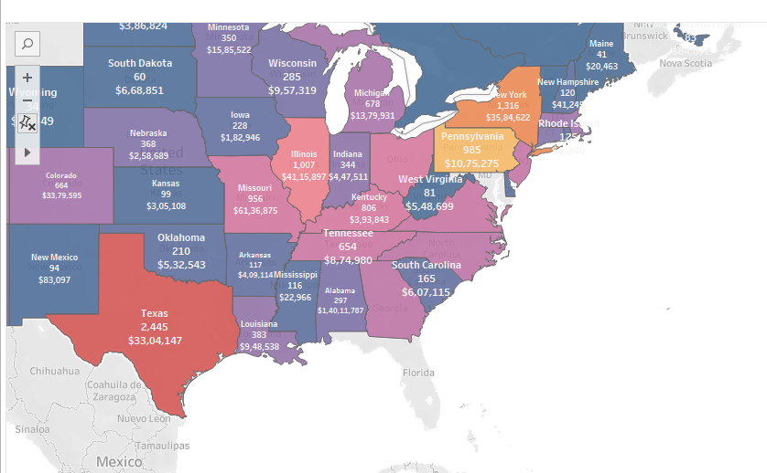
US states encountered Bird strikes

Slide 12
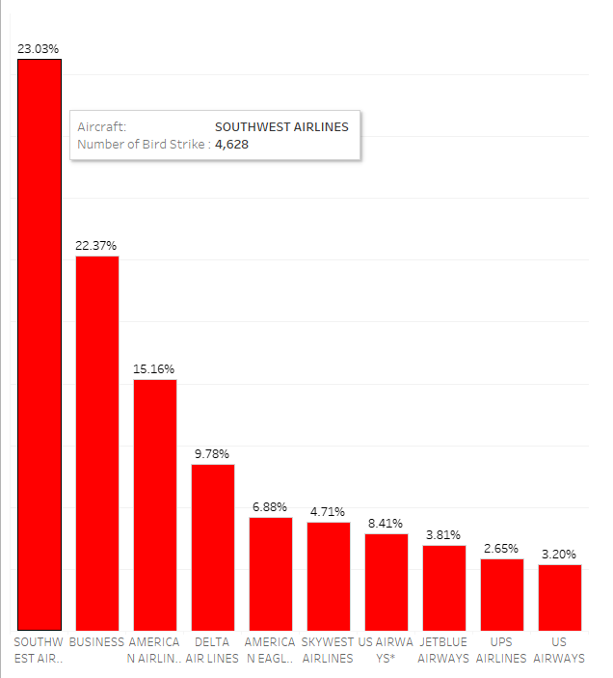
Top 10 Airlines affected by Strikes

Slide 13
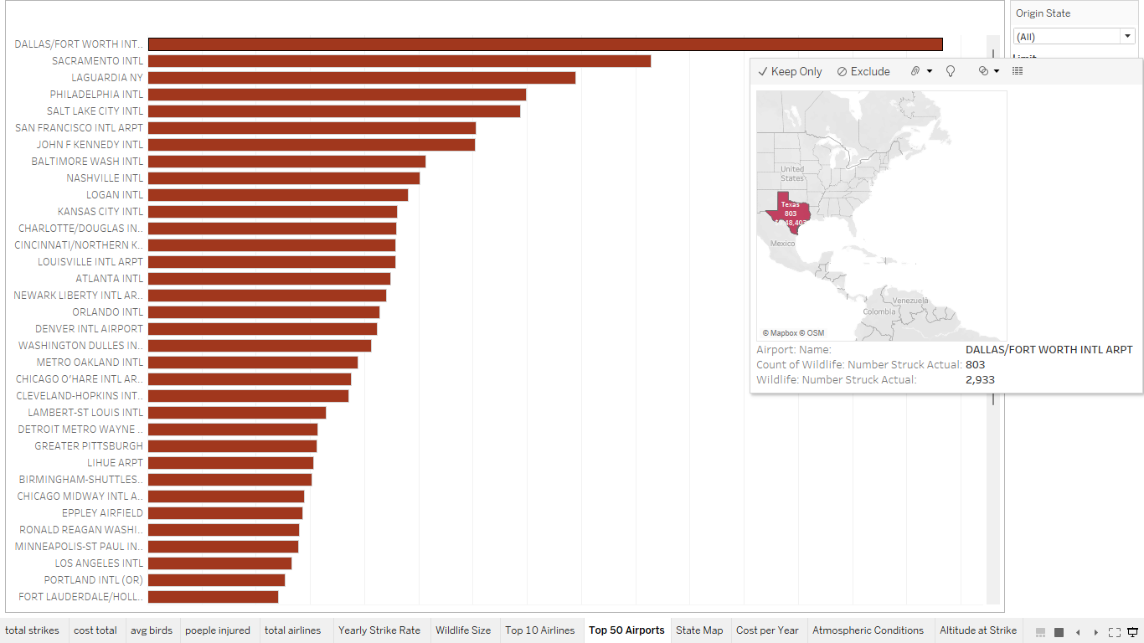
Top 50 Airports with corresponding strikes

Slide 14
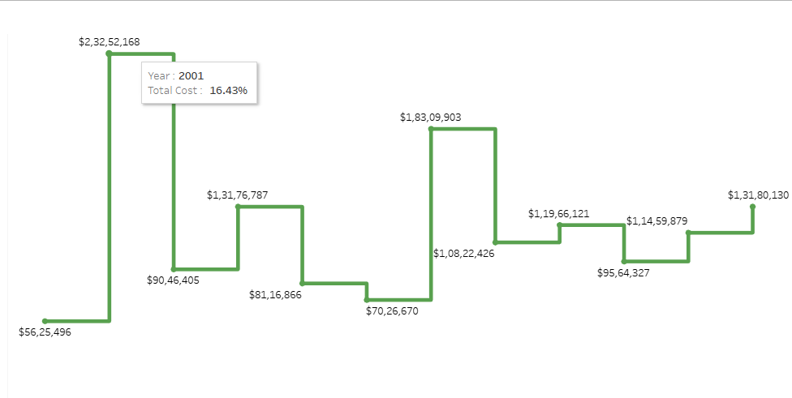
Cost Incurred per year

Slide 15
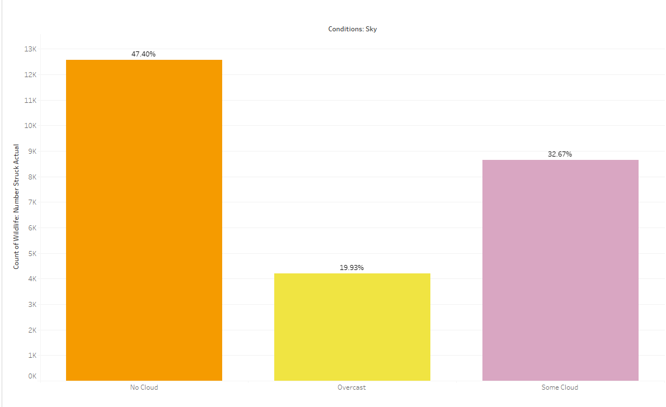
When do most bird strikes occur?

Slide 16
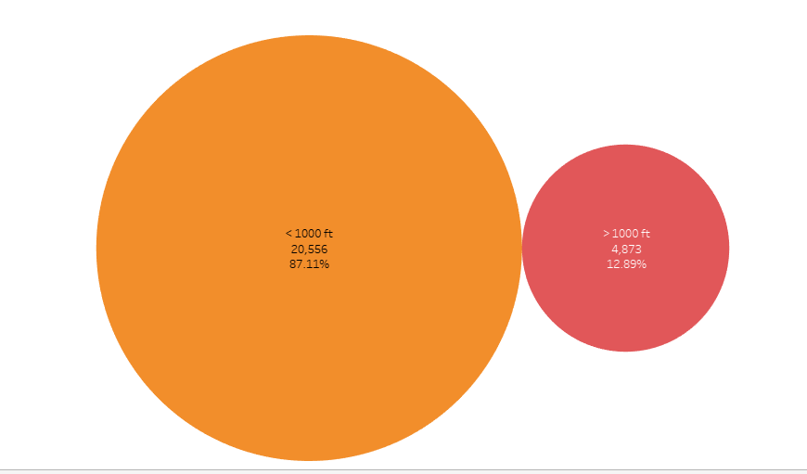
Altitude of Aeroplanes at the time of strike

Slide 17
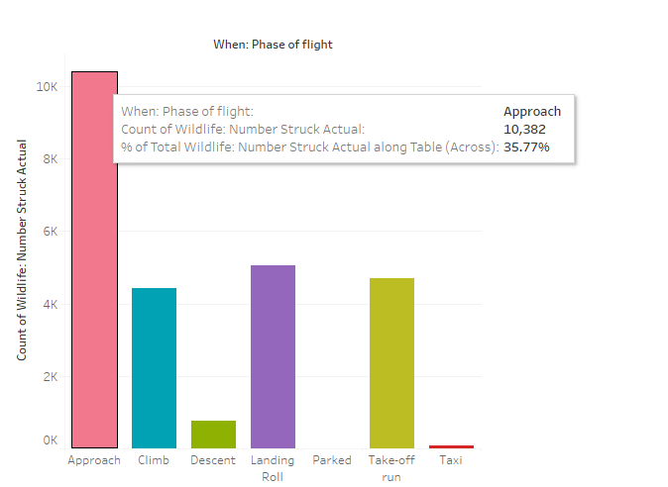
Phase of flight at the time of the strike.

Slide 18
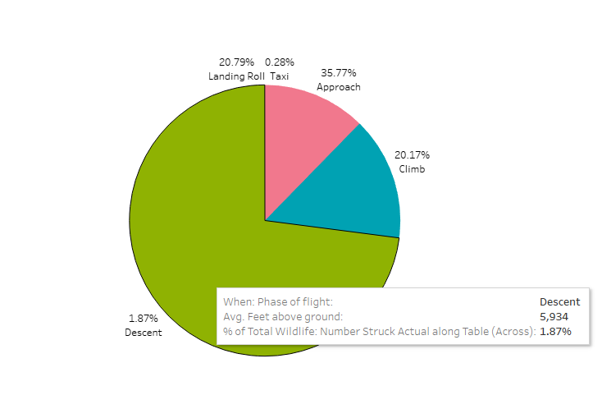
Average Altitude of the aeroplanes in different phases at the time of strike

Slide 19
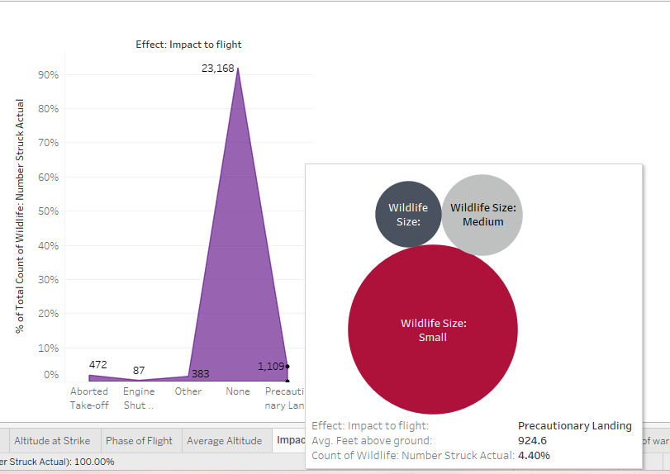
Effect of Bird Strikes & Impact on Flight

Slide 20
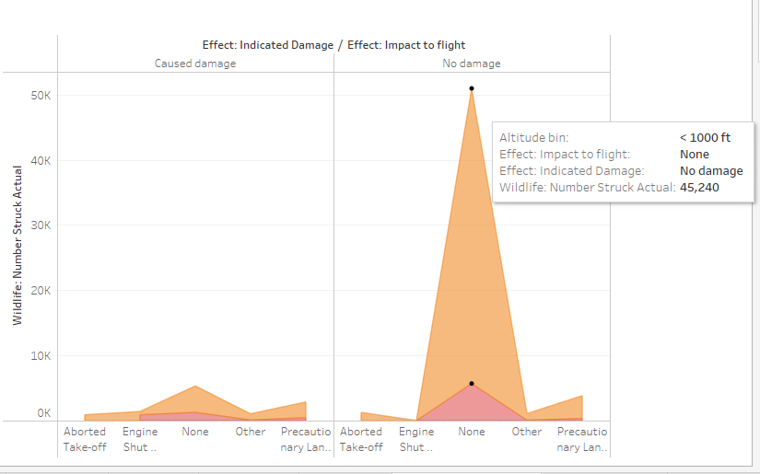
Effect of Bird Strikes & Impact on Flight

Slide 21
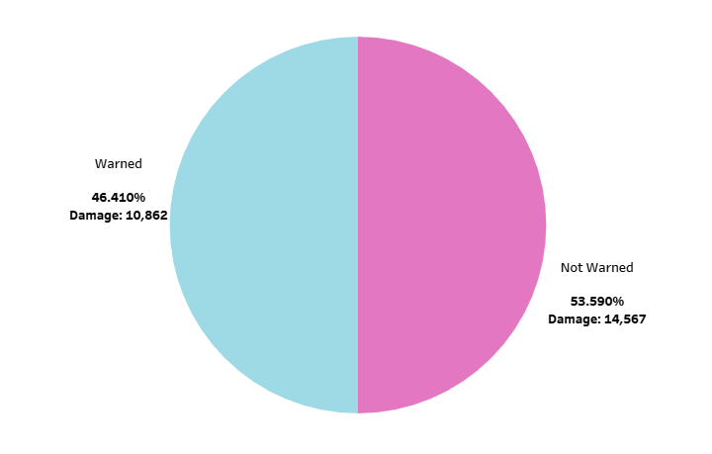
Were Pilots Informed: Prior Warning and Effect of Strike

Slide 22
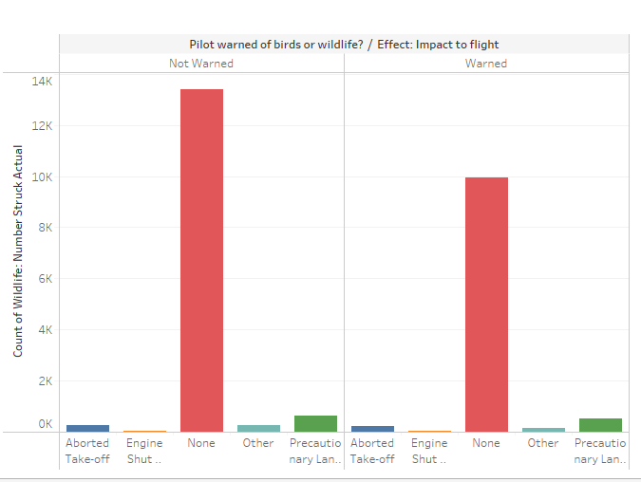
Were Pilots Informed: Prior Warning and Effect of Strike

Slide 23
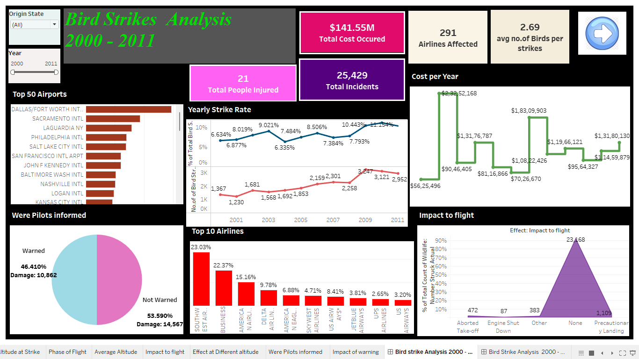
Bird Strike Analysis -Dashboard
07

Slide 24
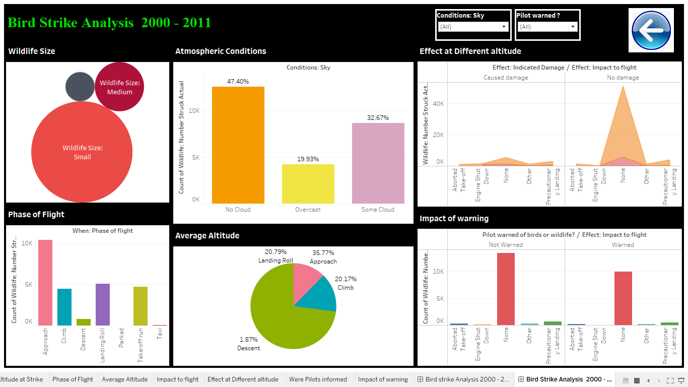
Bird Strike Analysis –Dashboard page 2

Slide 25
08
Impressions
Bird strike rate shows an upward trend during the years. 2009 and 2010 are the years with highest strikes rates.
Considering the Cost occurred due to damages, in 2001 highest damage happened
Around $2,32,52,168 and lowest in 2000
Out of the total, 75.75% of attacks were caused of Small Birds. Attacks caused by
Large wildlife are comparatively lower.
Texas ranks first in number of bird strikes cost incurred
86% of accidents happen in < 1000 ft and 35.7 % in the phase of Approach
Considering the atmospheric conditions, the Bird strikes stands high even if there is no cloud
Only 4.4% of strikes results in a Precautionary landing and 91.8% has not affected the flight
53.6 % of time the pilots are not prior warned of the bird strikes resulting in injured
passengers
The difference in damage with regarding the warning is 3705

Slide 26
THANK YOU

